Slide 1


TREATMENT MANUAL

Slide 2

BIODROGA MOISTURE BEAUTY TREATMENT
THE TREATMENT The skin is flooded with moisture and vitalized during the beauty treatment.
FOR WHOM IS THE TREATMENT SUITABLE? Customers who do not yet require intensive anti-age treatment Dehydrated skin with dryness wrinkles and/or a rough-looking skin surface Desire for refreshment and vitalization Summer treatment for dehydrated skin For all customers who want hydrated, refreshed and plump skin
THE FOCUS Intensive moisturizing of the skin Minimization of dryness lines and wrinkles Refreshment and plumping, as well as promotion of the skin's own vitality
THE RESULT An intensively moisturized, plump and vital skin. THE DURATION approx. 60 - 70 minutes moments of true beauty and relaxation.
2

Slide 3
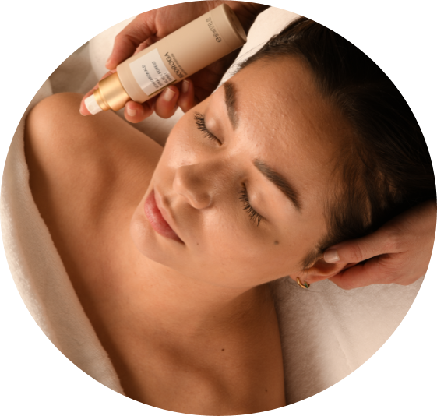
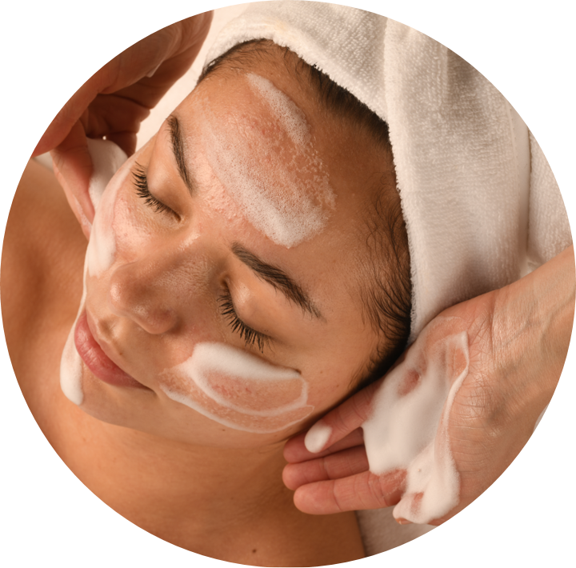
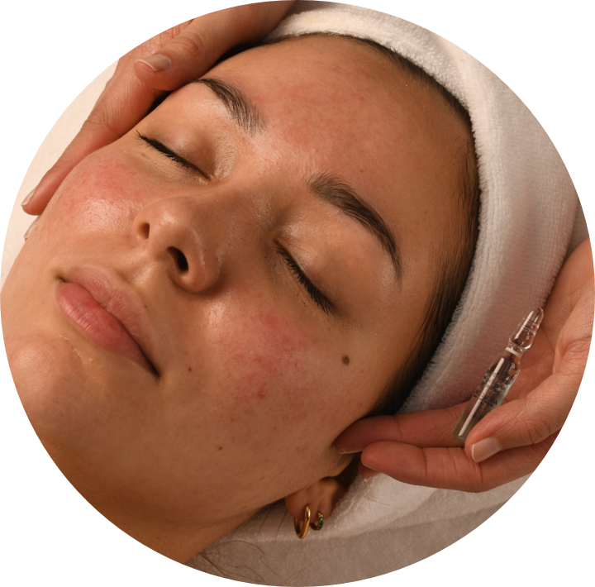
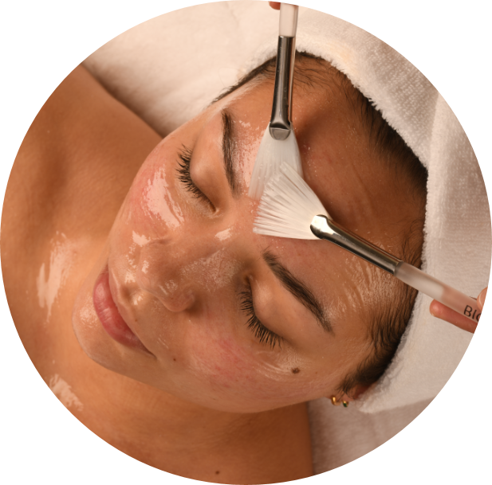
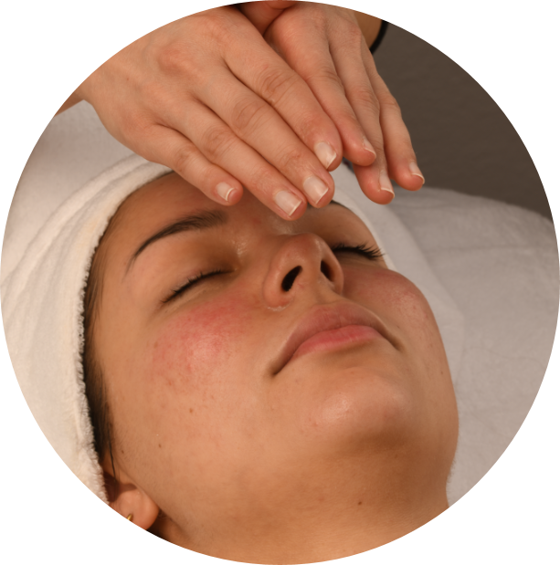
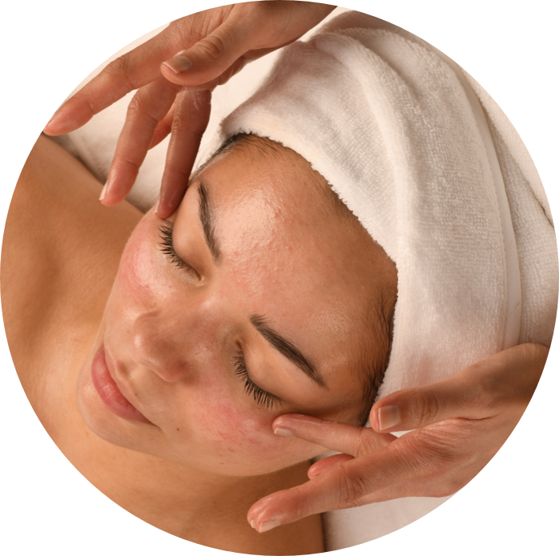
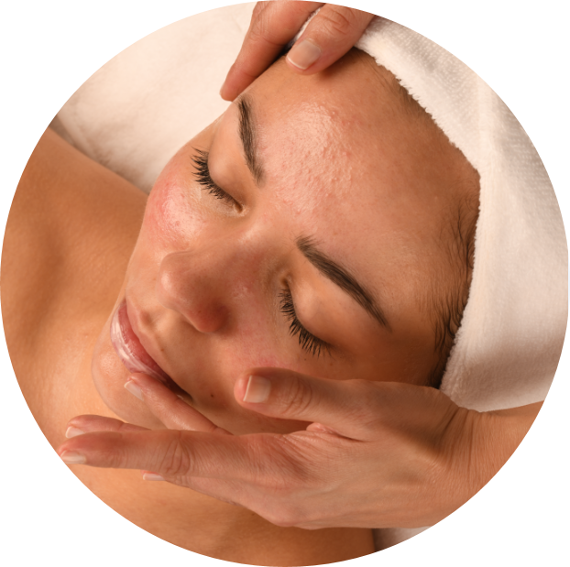
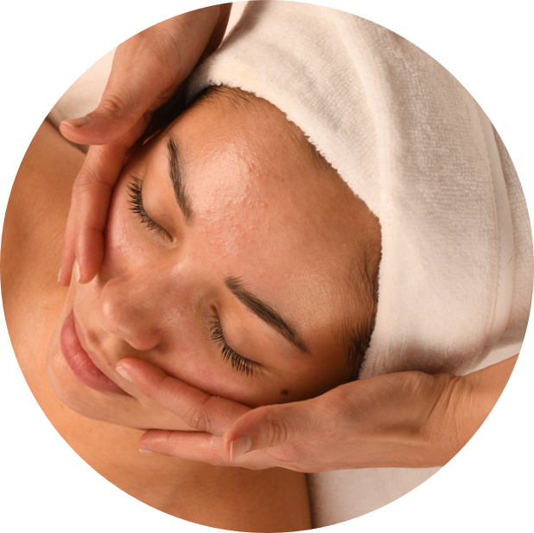
MOISTURE BEAUTY TREATMENT
BIODROGA BLACK FOREST RITUAL With Black Forest Spray according to instructions at end of manual.
CLEANSING & TONER For normal, combination and dry skin use Milky Cleanser and Skin Lotion Mild (toner) For oily or combination skin use Cleansing Fluid and Clarifying Lotion (toner)
PEELING Skin-specific. With Suggested Pro Starter Pack – MD Skin Refining Peeling 3% AHA
CONCENTRATE/SERUM Apply Hydra Boost Concentrate (can also use Golden Caviar Concentrate) and massage in. For possible combinations with technical devices, see the product manual.
MASK Apply Power Moist Mask a few millimeters thick to the skin and leave on for at least 10 minutes. After the exposure time, remove mask residue with water.
BIODROGA BLACK FOREST BEAUTY MASSAGE Perform the fragrance ritual with Black Forest Spray before starting the massage. As a massage medium use Biodroga Massage Cream. For instructions regarding the fragrance ritual and massage procedure see end of manual. Remove residues of the massage product with water.
EYE CARE & CARE CREAM Intense Moisture Formula Eye Care, Basic Moist and/or Intense Moisture Formula 24 Hour Care for dry skin.
LIP CARE PROGRAM WITH LIP MASSAGE Apply Firming Lip Treatment Lip Care thickly and incorporate with lip massage see end of manual. (it is not one of the products that is included in SUGGESTED STARTER PRO PACKAGE but you can definitely add it to your order.
SUN PROTECTION High UV Protection Cream SPF 50.
FINISH Spray Black Forest Spray into the air above the customer.
12

Slide 4
ANTI AGE BEAUTY TREATMENT
THE TREATMENT BIODROGA makes dreams come true with the pampering and at the same time effective ANTI AGE BEAUTY TREATMENT. Relaxing elements such as the BIODROGA Black Forest beauty massage are combined with the performance of effective products.
FOR WHOM IS THE TREATMENT SUITABLE? This treatment can already be used at the beginning of skin aging with the first lines and wrinkles up to pronounced lines and wrinkles.
THE FOCUS Smoothing of the skin surface Minimization of lines and wrinkles Tightening of the skin Intensive active ingredient supply for a radiant, youthful glow
THE RESULT A plump and smooth skin with natural radiance.
THE DURATION approx. 60 - 70 minutes moments of true beauty and relaxation.

Slide 5
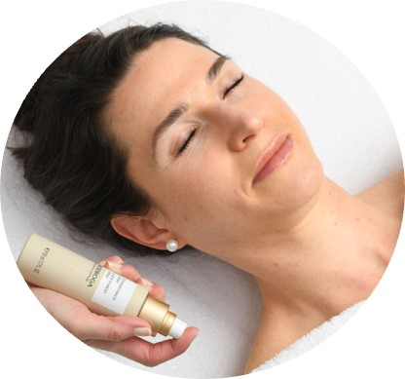
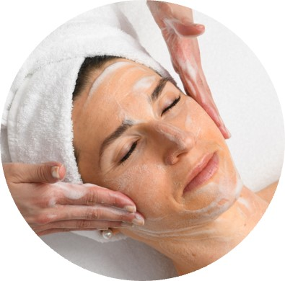
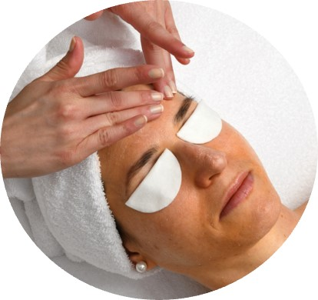
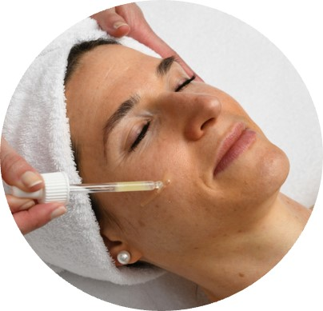
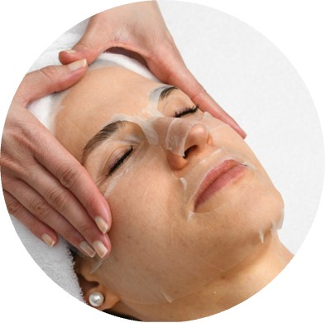
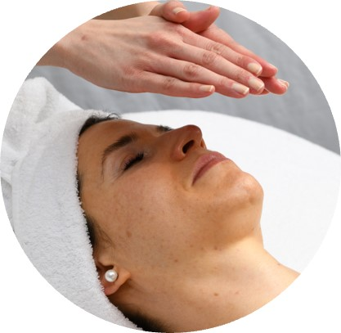
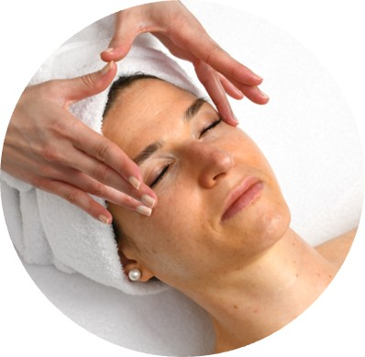
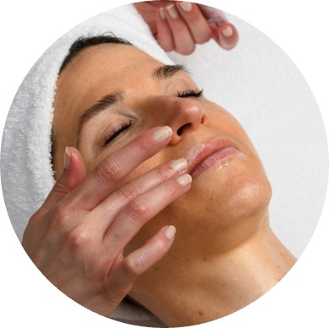
ANTI AGE BEAUTY TREATMENT
BIODROGA BLACK FOREST RITUAL With Black Forest Spray. See instructions at end of manual.
CLEANSING & TONER For normal, combination and dry skin use Milky Cleanser and Skin Lotion Mild (toner) For oily or combination skin use Cleansing Fluid and Clarifying Lotion (toner)
PEELING Skin-specific. With Suggested Pro Starter Pack – MD Skin Refining Peeling 3% AHA
CONCENTRATE/SERUM Apply Golden Caviar Concentrate (can substitute with Vitamin Boost Concentrate or Anti Age Serum) and massage in. For possible combinations with technical devices, see the product manual.
MASK Place a 360° Sheet Mask on the skin of the face and smooth it out. Apply Lifting Boost Mask a few millimeters thick on neck and décolleté. Mask exposure time 10 minutes. Remove the fleece and massage the remaining liquid into the skin. Remove residues of the Lifting Boost Mask. The residues can be removed particularly well with dry cosmetic tissues.
BIODROGA BLACK FOREST BEAUTY MASSAGE Perform the fragrance ritual with Black Forest Spray before starting the massage. As a massage medium use Anti Age 24h Care rich or massage cream. The instructions for the fragrance ritual and massage procedure can be found at the end of the manual. Remove residues from the massage product with water.
EYE CARE & CARE CREAM Apply Anti Age 24h Care and Anti Age Eye Care.
LIP CARE PROGRAM WITH LIP MASSAGE Apply Firming Lip Treatment Lip Care thickly and incorporate with lip massage see end of manual. (it is not one of the products that is included in SUGGESTED STARTER PRO PACKAGE but you can definitely add it to your order. SUN PROTECTION High UV Protection Cream SPF 50.
FINISH Spray Black Forest Spray into the air above the customer.

Slide 6

IMPURE SKIN/ACNE TREATMENT
THE TREATMENT Impure skin has many different facets. It can be afflicted with non-inflammatory and inflammatory impurities, underlays and comedones, as well as suffer from irritation and redness. BIODROGA provides a quick and lasting remedy with the clarifying special treatment.
FOR WHOM IS THE TREATMENT SUITABLE? This treatment can be used for various skin conditions of impure skin.
THE FOCUS Deep cleansing and clarification of the skin Counteracting existing skin impurities Preventing the development of new impurities Refinement of the skin texture Reduction of irritation and redness
THE RESULT A clear, well-groomed and refined complexion. THE DURATION Approx. 60 minutes acid-active ingredient power.

Slide 7
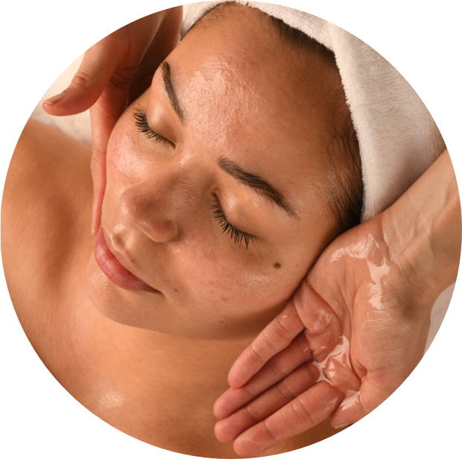
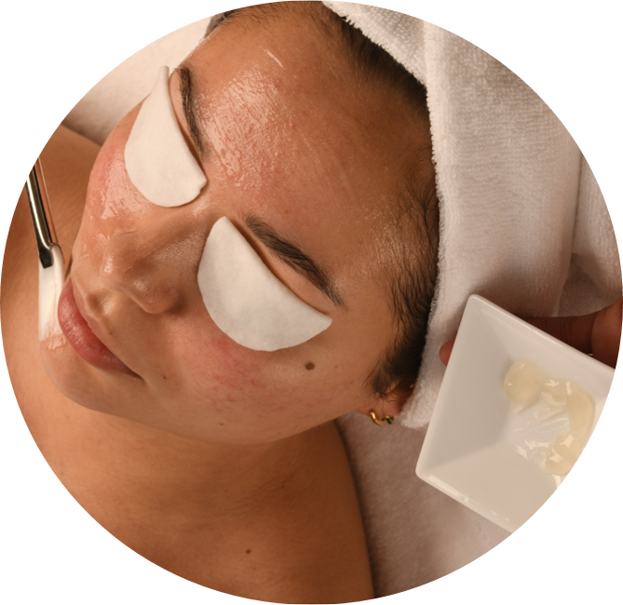
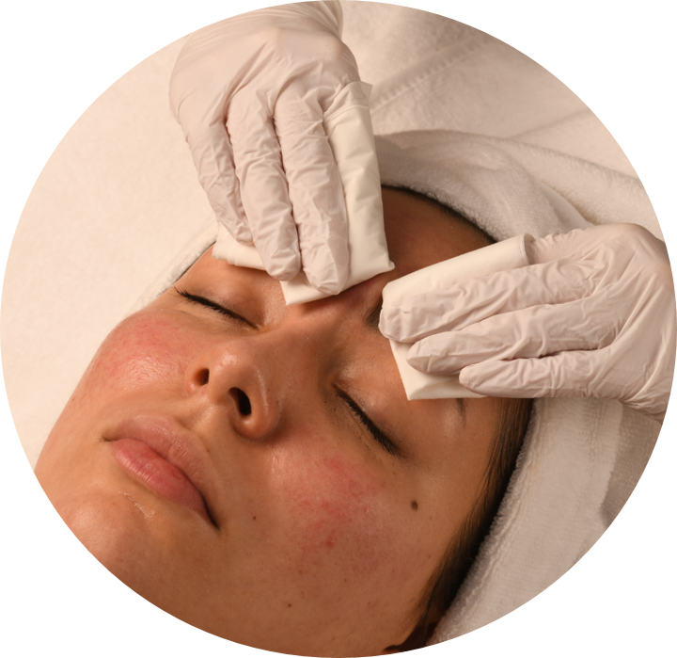
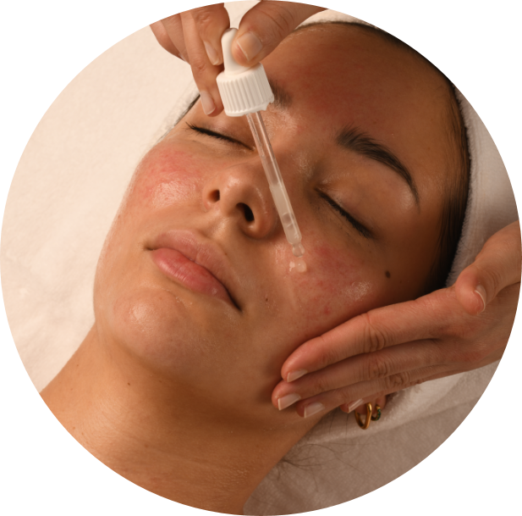
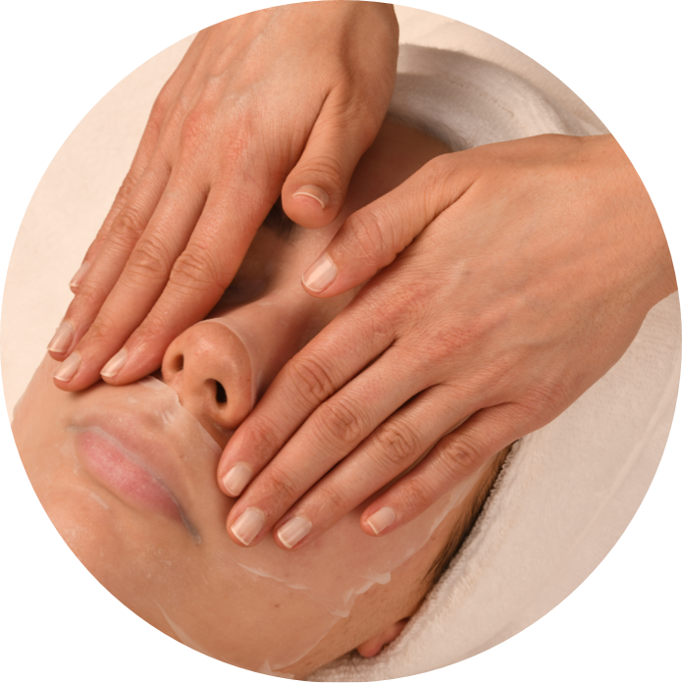
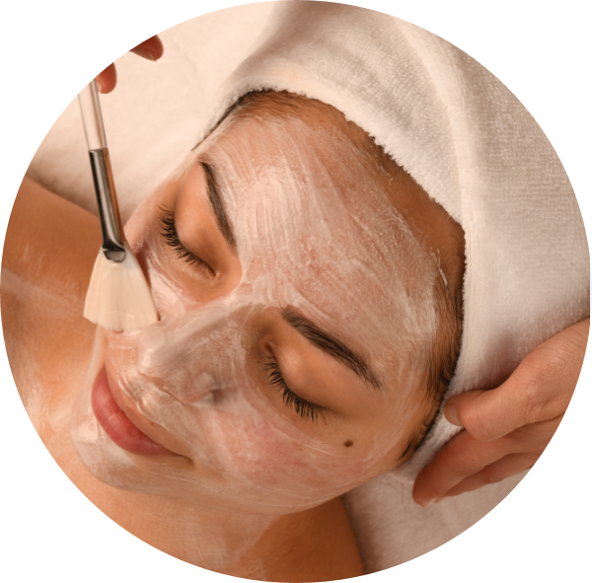
ACNE/IMPURE SKIN TREATMENT
CLEANSING & TONER skin-specific. Recommendation: Cleansing Fluid and Clarifying Lotion.
PEELING Skin-specific. With Suggested Pro Starter Pack – MD Skin Refining Peeling 3% AHA
DEEP CLEANSING Extract impurities and then disinfect skin areas that have been cleaned.
SERUMS Apply 3% Hyaluron Complex Serum in the layering process and massage in. The complete penetration of the serums takes place through the massage. DRAIN MASSAGE See at the end of manual. Optional: If stressed/irritated areas of the skin have developed as a result of the deep cleansing, perform the drain massage on top of the collagen pad (not included in opening order).
MASK Apply Clarifying Mask a few millimetres thick to the skin and leave on for at least 10 minutes. After the exposure time, remove mask residue with water.
EYE CARE & CARE CREAM Skin-specific eye care, Clear + 24h Care for impure combination skin.
SUN PROTECTION High UV Protection Cream LSF 50.

Slide 8
BIODROGA BLACK FOREST RITUAL
The relaxing Black Forest ritual welcomes every customer in the treatment and lets him/her sink deep into the magical world of the Black Forest. This makes it easy to "switch off" and get involved in the treatment. The combination of the Black Forest spray, relaxing grip techniques and sound recording, which invites you to travel your thoughts to the Black Forest, offers the perfect basis for a deeply relaxing treatment:
"Today you can enjoy a unique BIODROGA BIOSCIENCE INSTITUTE BEAUTY TREATMENT. Please close your eyes and follow me on a little journey to the Black Forest, the home of BIODROGA:
PREPARATION Wet your hands with approx. 3-4 pumps of Black Forest Spray and distribute in your palms.
TEXT THOUGHT JOURNEY STEP-1 "It's early in the morning, on a glorious summer day. The first rays of sunshine make their way through the dark fir branches and the light fog that hides in the treetops. You enjoy the lush green of the plants, especially the bright green of the fern."
MASSAGE FOR STEP-1 Place both hands flat in the middle of the forehead and slide slowly towards the temples. Slide sideways to the ears with flat hands. Spread the index and middle finger apart, "frame" the ear between the fingers and perform standing circles.
TEXT THOUGHT JOURNEY STEP-2 "The ground looks cuddly soft - it is overgrown with dense moss."
MASSAGE FOR STEP-2 Slide down the side of the neck to the décolleté and stroke on the towel-covered décolleté from the décolleté center to the shoulder balls.
TEXT THOUGHT JOURNEY STEP-3 "You now feel the first warm rays of sunshine that gently hit your face and breathe deeply in and out again. It smells wonderfully of forest. A pleasant scent of moss and floral elderberry is in the air. You feel comfortable and secure and enjoy moments of true beauty."
MASSAGE FOR STEP-3 Hands slide from the shoulder balls over the trapezius edge towards the neck, stroke forward to the décolleté center and hands are placed on top of each other on the décolleté center. Concentrate on the customer's breath, give gentle pressure when exhaling. Stroke one time laterally over the neck, temples to the tip of the head to end the ritual.

Slide 9
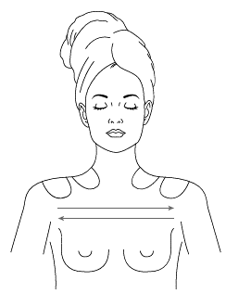
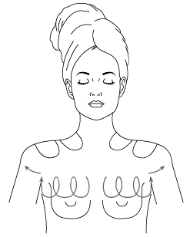
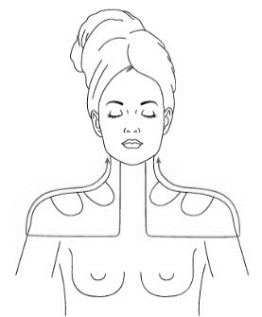
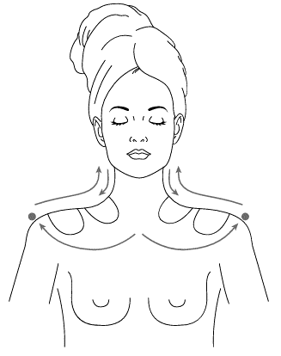
BIODROGA BLACK FOREST BEAUTY MASSAGE
Apply and distribute skin-specific massage product.
FRAGRANCE EXPERIENCE To get in the mood for the massage, apply 3-4 pumps of the Black Forest spray to your own palms and distribute. Ask the customer to take a deep breath. Focus on the breath. When inhaling "scented roof", hold your hands over the customer's nose (distance approx. 5 cm to skin contact), dissolve the scent roof when exhaling and apply pressure to the shoulder balls with your hands in parallel. Repeat a few breaths until you feel completely in tune with the customer.
1. RECIPROCAL STROKING FROM SHOULDER BALL TO SHOULDER BALL Right- and left-hand alternating.
2. CIRCLES IN A SWIMMING MOTION From décolleté center to the armpits. Lift the pectoral muscle slightly outwards. Settling back.
3. TWO-WAY TRIANGLE STROKE Right hand begins with the right side, the left hand strokes the left side with a time delay: the back of the hand glides gently from profundus to terminus. Palm strokes from décolleté center, shoulder ball over trapezius back to the starting point.
4. BUTTERFLY STROKE Form a fist and slide with the knuckles from term to profundus. Thumbs fix the shoulder balls, place hands flat on the décolleté and stroke back to the starting point, over décolleté, trapezius and neck.

Slide 10
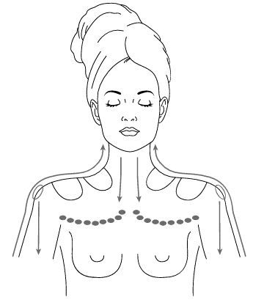
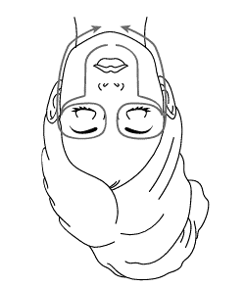
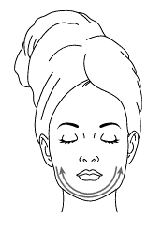
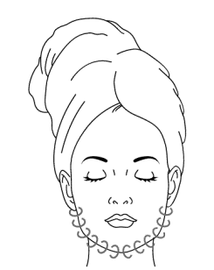
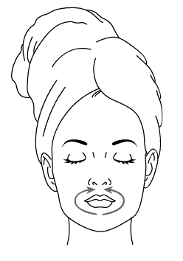
BIODROGA BLACK FOREST BEAUTY MASSAGE
5. ARM PIT STROKE WITH UPPER ARM STROKE Knuckles are moved from décolleté center to the armpits, fix shoulder ball with flat hand and cross the upper arm. Upper arm front descending, elbow region. Upper arm back ascending over shoulder blade, Occiput back to the starting point.
6. LARGE FACE STROKE Fix the chin bar between the index and middle fingers, slide outwards to the corner of the mouth. Maintain finger posture, pull up to the eye socket and slide to the temples. From the temples with middle and ring fingers over the cheekbone arch to the root of the nose. Above the eyebrows with a flat hand, slide back to the temples, give pressure and return to the starting point.
7. STROKING OUT THE CHIN BAR Stroke the chin bar from earlobe to earlobe. Right- and left-hand alternating.
8. KNEADING OF THE CHIN BAR Between thumb and the remaining fingers from earlobe to earlobe.
9. O-MOUTH Fix palms below the chin bar. Attach the thumb to the middle of the lower lip, stroke along the mouth ring muscle upwards to the middle of the upper lip. Settling back.

Slide 11
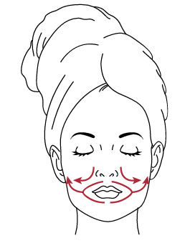
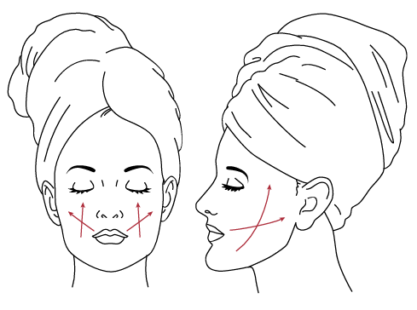
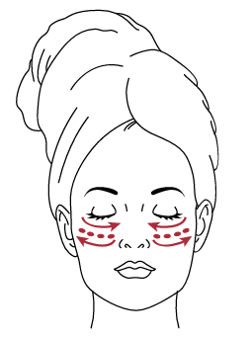
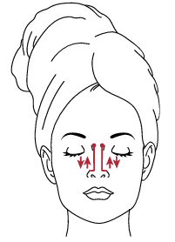
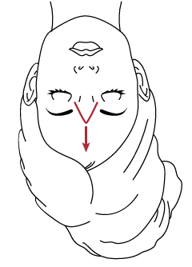
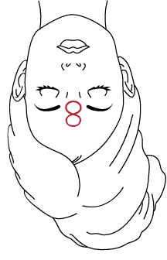
BIODROGA BLACK FOREST BEAUTY MASSAGE
10. BEARD STROKE With your thumbs, spread the nasolabial fold downwards. Use the fork stroke to fix the mouth between the index and middle fingers. Pull out to the corners of the mouth and then brush the cheeks outwards with the palms of your hands.
11. CROSS LIFTING STROKE Inner hand strokes the cheek area upwards, the outer hand strokes flat to the ear. Right and left cheeks alternately.
12. CHEEK BONE AREA Form a fist, work bones from the center of the face to the outside and back again. Work lifting strokes in several lanes.
13. NOSE STROKE GRIP Glide from the nostrils with the middle and ring fingers to the tip of the nose along the bridge of the nose to the root of the nose. Fix the acupressure point with the ring fingers for about 5 seconds, hold it and slide back to the starting point.
14. NOSE FORK GRIP Spread the middle and ring fingers. Stroke the root of the nose ascending with the fork grip. Right- and left-hand alternating.
15. FIGURE EIGHT FROWN LINES Stretch the frown line between the middle and ring fingers. Draw a vertical eight with your right hand with your middle and ring fingers.

Slide 12
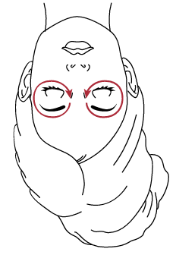
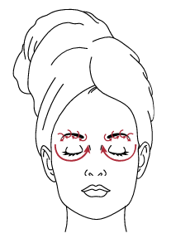
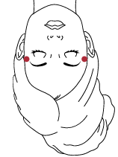
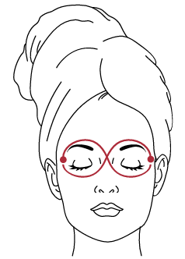
BIODROGA BLACK FOREST BEAUTY MASSAGE
16. STROKING THE EYE RING MUSCLE Glide over the eyebrows from the inside to the outside with your finger surfaces. Brush back below the eyes with the middle and ring fingers.
17. KNEADING THE EYEBROWS From the eyebrow root to the outside, knead the eyebrows between the thumb and index fingers. Swipe back below the eyes with your index finger.
18. PRESSURE AT THE TEMPLES With middle and ring fingers.
19. BIG EIGHT With the middle and ring fingers of the right hand, fix the temple of the right part of the face. Glide with the middle and ring fingers of the left hand below the right eye, over the root of the nose and above the eyebrow to the temple of the left part of the face. Fix the left temple and repeat the process inverted.
20. TRANSITIONAL GRIP STROKE OF THE EYE RING MUSCLE Perform this stroke only 1x.

Slide 13
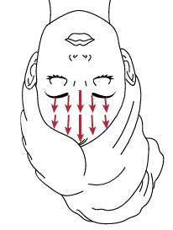
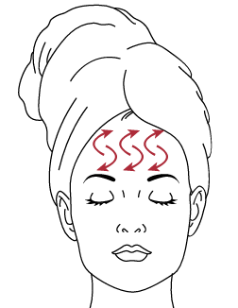
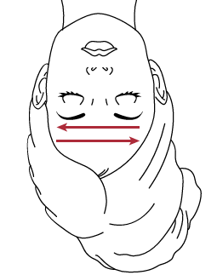
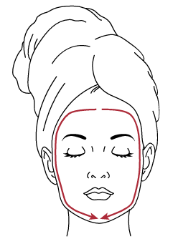
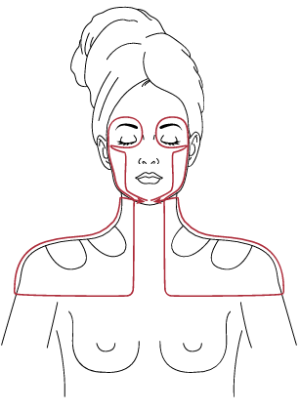
BIODROGA BLACK FOREST BEAUTY MASSAGE
21. MASSAGING THE FOREHEAD OVER A LARGE AREA In the middle starting with the palms of the hand, hand over hand stroke the forehead from the eyebrows to the hairline. Then spread hand over hand from temple to temple.
22. CRESCENT STROKE Counter-rotating crescent strokes with middle and ring fingers from temple to temple.
23. RECIPROCAL FOREHEAD STROKE With a flat hand from temple to temple.
24. TRANSITION STROKE From the forehead over the temples to the chin. Perform stroke only 1x.
25. LARGE FINISHING STROKE Fix the chin bar between the index and middle fingers, slide outwards to the corner of the mouth. Maintain finger posture, pull up to the eye socket and slide to the temples. Then with middle and ring fingers from the temples over the cheekbone arch to the root of the nose. Above the eyebrows with flat hands, slide back to the temples and give pressure. From the temples laterally over the neck, over the décolleté, along the trapezius back to the starting point. During the last time, finish the stroke on the shoulder balls with pressure.

Slide 14
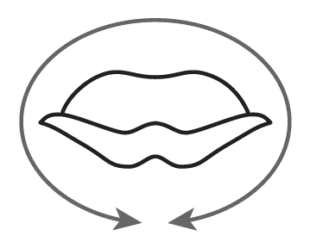
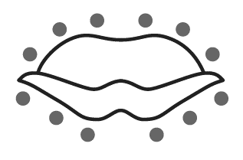
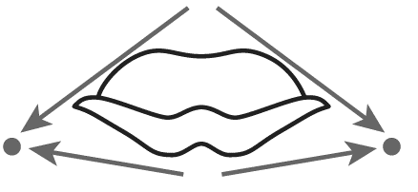
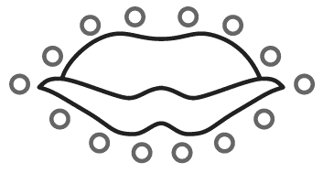



BIODROGA LIP MASSAGE
1. O-MOUTH Fix palms below the chin bar. Attach the thumb in the middle of the lower lip, stroke along the mouth ring muscle upwards to the middle of the upper lip. Settling back.
2. LIP CIRCLES Attach fingertips of the right and left hand to the upper lip contour and perform standing circles in the direction of swimming. Then attach fingertips to the lower lip contour and repeat circles.
3. LIP SMILE Frame the lip between the index and middle fingers of the right and left hands. Spread out slightly ascending to the corner of the mouth. Fix the smile for 1–2 seconds, settling back to the starting point.
4. LIP PALPATION Tap out lips and lip contour with drumming fingertips.
5. COUNTER-ROTATING CRESCENT STROKES ALONG THE LIP CONTOUR With index fingers of the right and left hand.
6. LIP SLIDING With index fingers of the right and left hand, perform counter-rotating crescent strokes around the lip contour.
7. SILENT LIP Stroke mouth with flat hand from corner of mouth to the other corner of the mouth. Right- and left-hand alternating.

Slide 15
BIODROGA – DRAIN MASSAGE
PREPARATION Adjust the headboard of the treatment bed so that it is slightly elevated (no pillow).
APPLICATION NOTES
Place the fingertips flat and follow the little finger with gentle pressure. Perform a standing, pumping movement. Then remove pressure and let your hands bounce back from the skin.
Do not perform an active upward movement.
Lead the palms as linearly as possible to the bridge of the nose.
Perform each stroke 1x.
As a rule, repeat the pump movement on a position 3-5 times. Attention: for exceptions see massage procedure.

Slide 16




BIODROGA – DRAIN MASSAGE
ATTUNEMENT With spread fingers, perform gentle strokes from the sternum to the armpits. Settling back to the starting point. Repeat strokes 5 times.
PUMPING STROKE 1
Position 1: Profundus below earlobes
Position 2: Intermediate station, center lateral neck
Position 3: Terminus, in collarbone pit
Position 4: Décolleté on the sternum
PUMPING STROKE 2
Position 1: Occiput fingertips lie parallel to cervical vertebral. Attention Exception: Apply pumping movement towards the index finger
Position 2: Profundus below earlobes
Position 3: Intermediate station, center lateral neck
Position 4: Terminus, in collarbone pit
Position 5: Décolleté on the sternum
PUMPING STROKE 3
Position 1: Index finger in front of the ear, remaining fingers behind the ear
Position 2: Profundus below earlobes
Position 3: Intermediate station, center lateral neck
Position 4: Terminus, in collarbone pit
Position 5: Décolleté on the sternum

Slide 17






BIODROGA – DRAIN MASSAGE
RELIEF STROKE 1
Position 1: Chin center below the lower lip
Position 2: Center chin bar
Position 3: Temporomandibular joint angle
RELIEF STROKE 2
Position 1: Under the nose
Attention Exception: Middle and ring fingertips
Position 2: Laterally the corner of the mouth
Position 3: Middle of the ear
RELIEF STROKE 3
Attention Exception: Middle fingertips
Position 1: Nose tip
Position 2: Nose bridge
Position 3: Nasal root
RELIEF STROKE 4
Position 1: Lower eyelid - eyes
Position 2: Tempels
RELIEF STROKE 5
Position 1: Eyebrows
Position 2: Tempels
RELIEF STROKE 6
Position 1: Forehead center
Position 2: Forehead side
Position 3: Tempels

Slide 18


BIODROGA – DRAIN MASSAGE
DRAIN STROKE 1
Position 1: Middle of the ear
Position 2: Temporomandibular joint
Position 3: Profundus - Attention Exception: 20 * Pumps
DRAIN STROKE 2
Position 1: Intermediate station, center lateral neck
Position 2: Terminus, in collarbone pit
Position 3: Décolleté
DISMISSAL With spread fingers, perform gentle strokes from the sternum to the armpits. Settling back to the starting point. Repeat strokes 5*.

